Slide 1
Enough Coverage To Beat The Band
Kevin Murphy

Slide 2
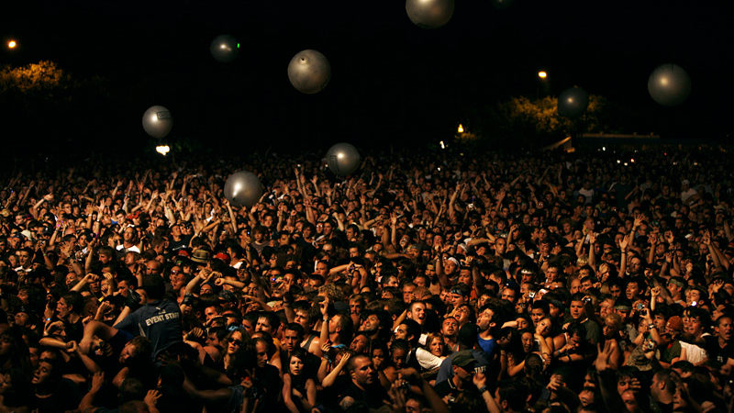
Nine Inch Nails
CC BY-NC-SA 2.0
Notes:
https://www.flickr.com/photos/nineinchnails/2738980841/

Slide 4
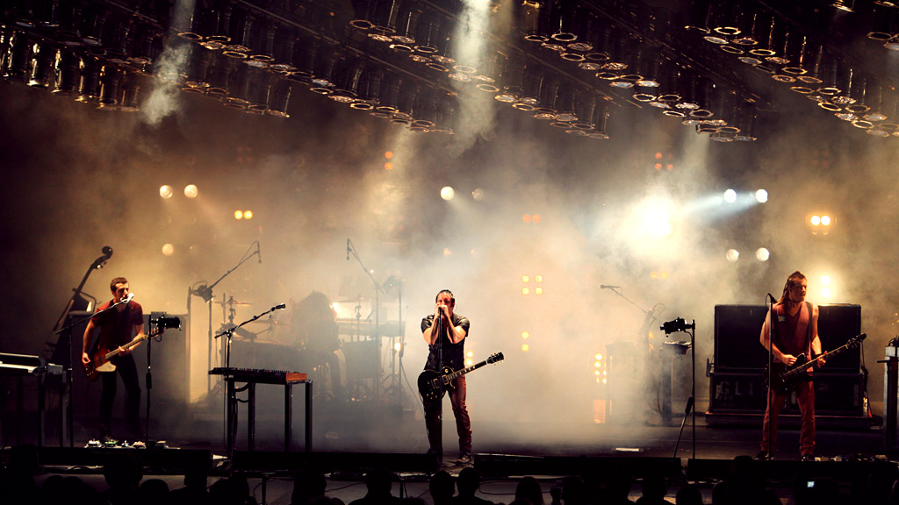
Nine Inch Nails
CC BY-NC-SA 2.0
Notes:
https://www.flickr.com/photos/nineinchnails/3639150601/

Slide 5
concert = Concert.new(“RubyFest")

Slide 6
Coverage

Slide 7

@kevin_j_m
Kevin Murphy

Slide 8
Test Coverage

Slide 9
setlist.add_song(TheLineBeginsToBlur.new)

Slide 10
setlist.add_song(TheLineBeginsToBlur.new)
setlist.add_song(OneShotWayToGetThere.new)

Slide 11
setlist.add_song(TheLineBeginsToBlur.new)
setlist.add_song(OneShotWayToGetThere.new)
setlist.add_song(VariousMethodsOfEscape.new)

Slide 12
setlist.add_song(TheLineBeginsToBlur.new)
setlist.add_song(OneShotWayToGetThere.new)
setlist.add_song(VariousMethodsOfEscape.new)
setlist.add_song(BranchesBones.new)

Slide 13
setlist.add_song(TheLineBeginsToBlur.new)
setlist.add_song(OneShotWayToGetThere.new)
setlist.add_song(VariousMethodsOfEscape.new)
setlist.add_song(BranchesBones.new)
concert.setlist = setlist

Slide 14
concert.perform

Slide 15
setlist.songs
[
TheLineBeginsToBlur.new,
OneShotWayToGetThere.new,
VariousMethodsOfEscape.new,
BranchesBones.new,
]

Slide 16
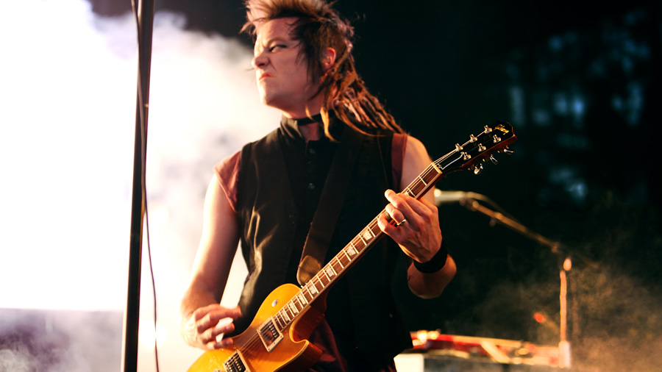
The Line Begins To Blur
Nine Inch Nails
CC BY-NC-SA 2.0
Caption
Notes:
https://www.flickr.com/photos/nineinchnails/3573650628/

Slide 17

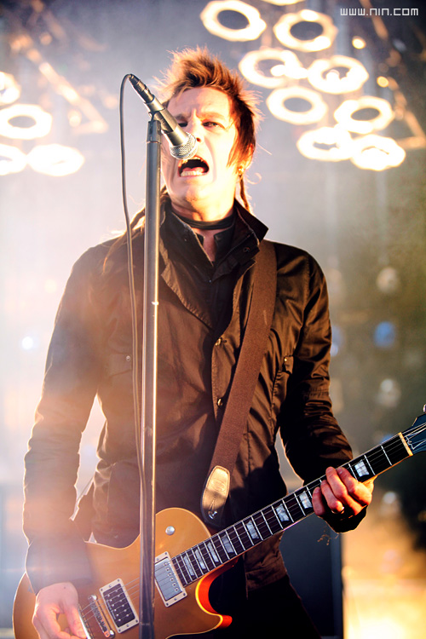
The Line Begins To Blur
Nine Inch Nails CC BY-NC-SA 2.0
class String
def pluck(fret:)
end
end
Notes:
https://www.flickr.com/photos/nineinchnails/3573650014/

Slide 18
The Line Begins To Blur
Nine Inch Nails CC BY-NC-SA 2.0
class String
def pluck(fret:)
if exhausted?
break_string
end
end
end
Notes:
https://www.flickr.com/photos/nineinchnails/3573650014/

Slide 19
The Line Begins To Blur
Nine Inch Nails CC BY-NC-SA 2.0
class String
def pluck(fret:)
if exhausted?
break_string
else
@tension -= 1
play_note(fret)
end
end
end
Notes:
https://www.flickr.com/photos/nineinchnails/3573650014/

Slide 20

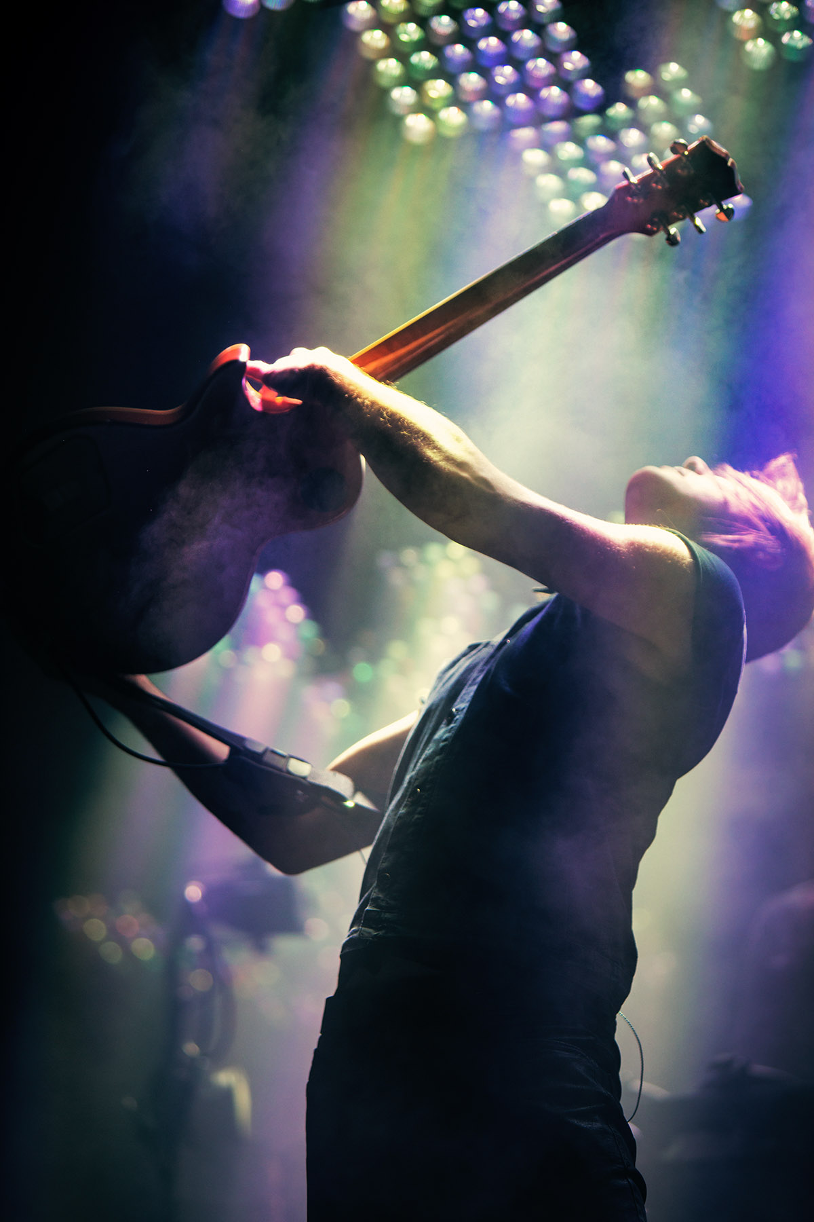
The Line Begins To Blur
Nine Inch Nails CC BY-NC-SA 2.0
class String
def exhausted?
@tension.negative?
end
end
Notes:
https://www.flickr.com/photos/nineinchnails/10722222236

Slide 21
The Line Begins To Blur
Nine Inch Nails CC BY-NC-SA 2.0
class String
def exhausted?
@tension.negative? || rand(1..1000) == 3
end
end
Notes:
https://www.flickr.com/photos/nineinchnails/10722222236

Slide 22

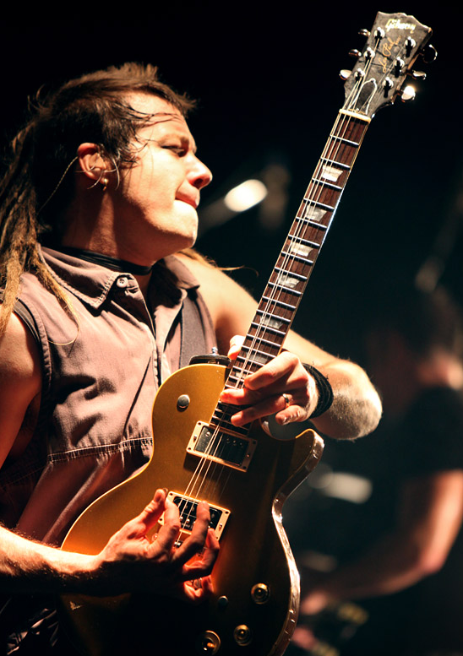
The Line Begins To Blur
Nine Inch Nails CC BY-NC-SA 2.0
class String
def break_string
end
end
Notes:
https://www.flickr.com/photos/nineinchnails/3639160537/

Slide 23
The Line Begins To Blur
Nine Inch Nails CC BY-NC-SA 2.0
class String
def break_string
@broken = true
end
end
Notes:
https://www.flickr.com/photos/nineinchnails/3639160537/

Slide 24
The Line Begins To Blur
Nine Inch Nails CC BY-NC-SA 2.0
class String
def break_string
@broken = true
BrokenStringSound.new
end
end
Notes:
https://www.flickr.com/photos/nineinchnails/3639160537/

Slide 25
The Line Begins To Blur
# lib/tour_leg_1.rb
10.times do
end

Slide 26
The Line Begins To Blur
# lib/tour_leg_1.rb
10.times do
concert.perform
end

Slide 27
The Line Begins To Blur
require "coverage"

Slide 28
The Line Begins To Blur
require "coverage"
Coverage.start(lines: true)

Slide 29
The Line Begins To Blur
require "coverage"
Coverage.start(lines: true)
load "lib/tour_leg_1.rb"

Slide 30
The Line Begins To Blur
require "coverage"
Coverage.start(lines: true)
load "lib/tour_leg_1.rb"
result = Coverage.result

Slide 31
The Line Begins To Blur
{
"lib/tour_leg_1.rb"=> {:lines => […]},
…
"…guitar/string.rb" => {:lines => [1, 1, 1, 1, 1, 1, nil,…]},
…
}

Slide 32
The Line Begins To Blur
{
"…guitar/string.rb" => {:lines => [1, 1, 1, 1, 1, 1, nil,…]},
}

Slide 33
The Line Begins To Blur
File
{
"…guitar/string.rb" => {:lines => [1, 1, 1, 1, 1, 1, nil,…]},
}

Slide 34
The Line Begins To Blur
File
{
"…guitar/string.rb" => {:lines => [1, 1, 1, 1, 1, 1, nil,…]},
}
Mode

Slide 35
The Line Begins To Blur
File
Line 1 Count
{
"…guitar/string.rb" => {:lines => [1, 1, 1, 1, 1, 1, nil,…]},
}
Mode

Slide 36
The Line Begins To Blur
File
Line 1 Count
{
"…guitar/string.rb" => {:lines => [1, 1, 1, 1, 1, 1, nil,…]},
}
Mode
Irrelevant Line 7

Slide 37

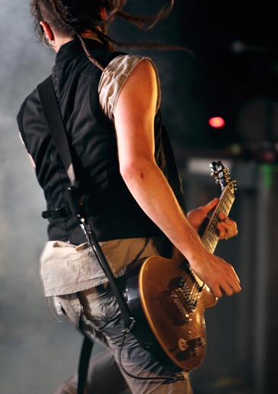
The Line Begins To Blur
4
5
6
7
8
Nine Inch Nails CC BY-NC-SA 2.0
class String
attr_reader :tension
attr_reader :tuning_note
def initialize(number:, tuning_note:)
end
Notes:
https://www.flickr.com/photos/nineinchnails/3572799825/

Slide 38
The Line Begins To Blur
string_lines = result["…guitar/string.rb"][:lines]

Slide 39
The Line Begins To Blur
53
54
55
56
Nine Inch Nails CC BY-NC-SA 2.0
class String
def break_string
@broken = true
BrokenStringSound.new
end
end
Notes:
https://www.flickr.com/photos/nineinchnails/3639160537/

Slide 40
The Line Begins To Blur
53
54
55
56
Nine Inch Nails CC BY-NC-SA 2.0
class String
def break_string
@broken = true
BrokenStringSound.new
end
end
Notes:
https://www.flickr.com/photos/nineinchnails/3639160537/

Slide 41
The Line Begins To Blur
string_lines = result["…guitar/string.rb"][:lines]

Slide 42
The Line Begins To Blur
string_lines = result["…guitar/string.rb"][:lines]
"Number of broken strings: #{string_lines[53]}"

Slide 43
The Line Begins To Blur
string_lines = result["…guitar/string.rb"][:lines]
"Number of broken strings: #{string_lines[53]}"
=> Number of broken strings: 16

Slide 44
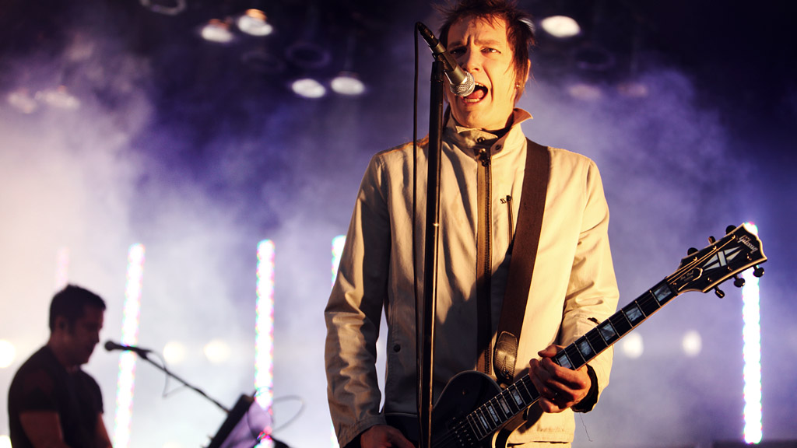
Nine Inch Nails
CC BY-NC-SA 2.0
Notes:
https://www.flickr.com/photos/nineinchnails/3639938714/

Slide 45
setlist.songs
[
TheLineBeginsToBlur.new,
OneShotWayToGetThere.new,
VariousMethodsOfEscape.new,
BranchesBones.new,
]

Slide 46
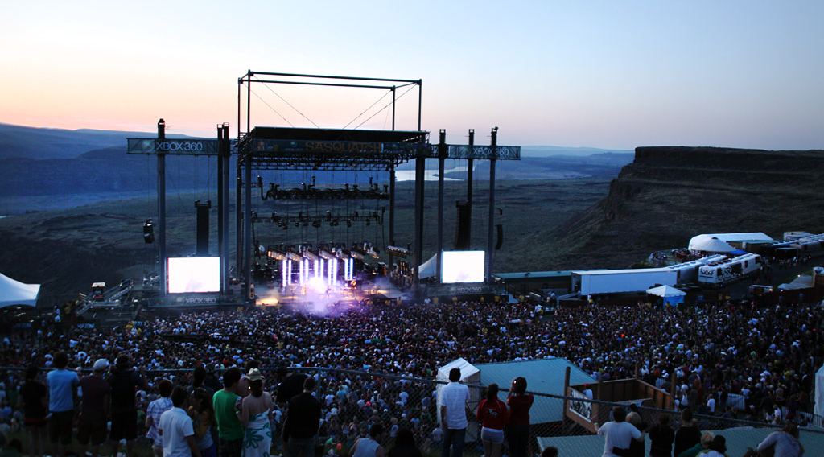
One(Shot) Way To Get There
Nine Inch Nails
CC BY-NC-SA 2.0
Notes:
https://www.flickr.com/photos/nineinchnails/3639113025/

Slide 47
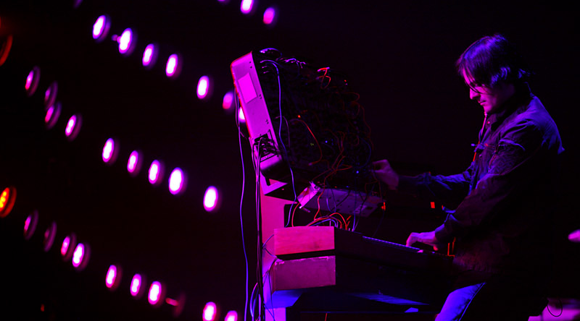
One(Shot) Way To Get There
Nine Inch Nails
CC BY-NC-SA 2.0
Notes:
https://www.flickr.com/photos/nineinchnails/3032772287/

Slide 48
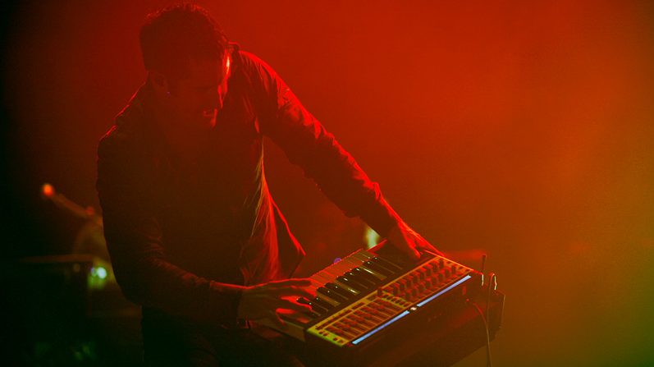
One(Shot) Way To Get There
Nine Inch Nails
CC BY-NC-SA 2.0
Notes:
https://www.flickr.com/photos/nineinchnails/2739834768

Slide 49
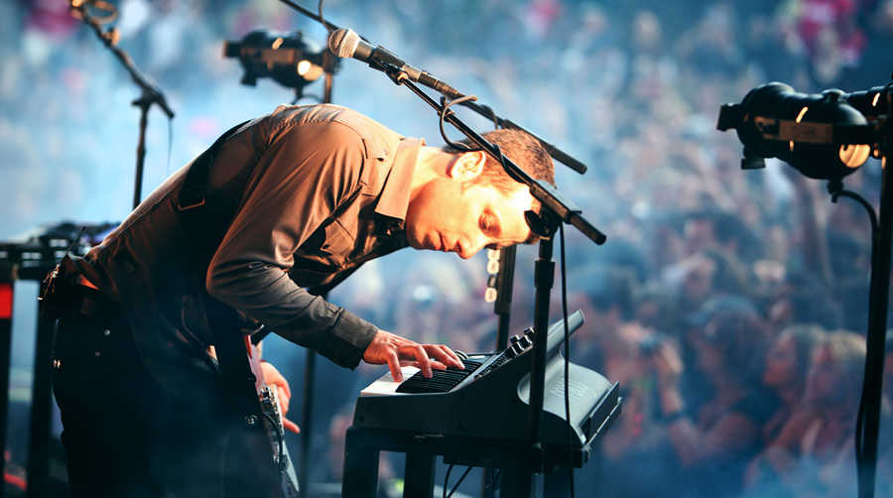
One(Shot) Way To Get There
Nine Inch Nails
CC BY-NC-SA 2.0
Notes:
https://www.flickr.com/photos/nineinchnails/3573642602

Slide 50
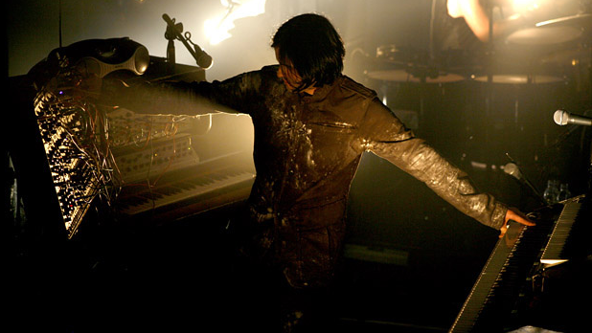
One(Shot) Way To Get There
Nine Inch Nails
CC BY-NC-SA 2.0
Notes:
https://www.flickr.com/photos/nineinchnails/3212245282

Slide 51
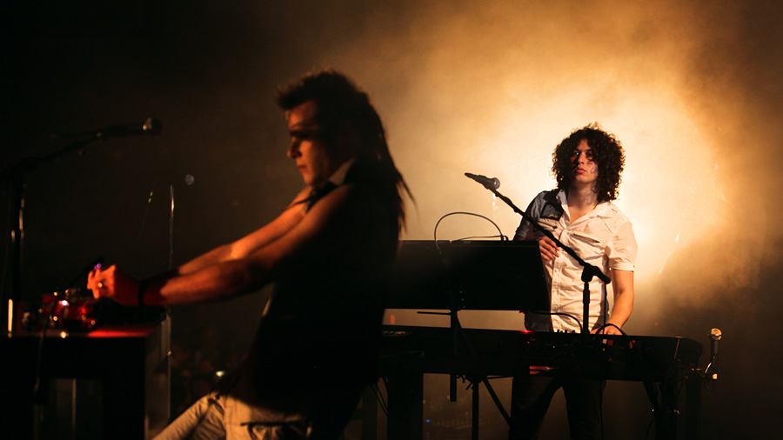
One(Shot) Way To Get There
Nine Inch Nails
CC BY-NC-SA 2.0
drummer
Notes:
https://www.flickr.com/photos/nineinchnails/3573605580/

Slide 52

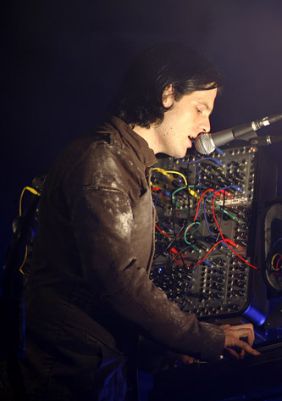
One(Shot) Way To Get There
Nine Inch Nails CC BY-NC-SA 2.0
class Patch
attr_reader :sound
attr_reader :effect
attr_reader :filter
attr_reader :oscillator
end
Notes:
https://www.flickr.com/photos/nineinchnails/3211397961/

Slide 53

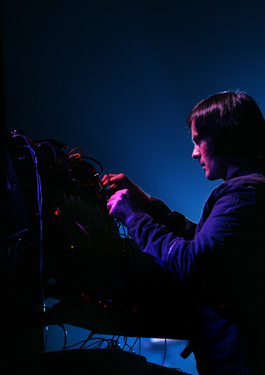
One(Shot) Way To Get There
Nine Inch Nails CC BY-NC-SA 2.0
class Synthesizer
def program(note)
end
end
Notes:
https://www.flickr.com/photos/nineinchnails/2827641506/

Slide 54
One(Shot) Way To Get There
Nine Inch Nails CC BY-NC-SA 2.0
class Synthesizer
def program(note)
set_patch(note.synth_sound.patch)
end
end
Notes:
https://www.flickr.com/photos/nineinchnails/2827641506/

Slide 55
One(Shot) Way To Get There
Nine Inch Nails CC BY-NC-SA 2.0
class Synthesizer
def program(note)
set_patch(note.synth_sound.patch)
play_key(
key: note.synth_sound.key,
duration: note.duration,
)
end
end
Notes:
https://www.flickr.com/photos/nineinchnails/2827641506/

Slide 56

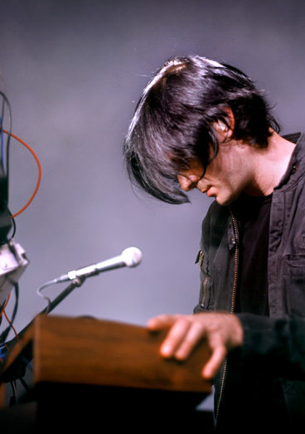
One(Shot) Way To Get There
Nine Inch Nails CC BY-NC-SA 2.0
class MoogPatchMemory
def read(location)
case location
…
end
end
end
Notes:
https://www.flickr.com/photos/nineinchnails/2768600347/

Slide 57
One(Shot) Way To Get There
Nine Inch Nails CC BY-NC-SA 2.0
class MoogPatchMemory
def read(location)
case location
…
end
end
end
Notes:
https://www.flickr.com/photos/nineinchnails/2768600347/

Slide 58
One(Shot) Way To Get There
Nine Inch Nails CC BY-NC-SA 2.0
case location
end
end
end
Notes:
https://www.flickr.com/photos/nineinchnails/2768600347/

Slide 59
One(Shot) Way To Get There
Nine Inch Nails CC BY-NC-SA 2.0
case location
when :a1
@memory[0]
end
end
end
Notes:
https://www.flickr.com/photos/nineinchnails/2768600347/

Slide 60
One(Shot) Way To Get There
Nine Inch Nails CC BY-NC-SA 2.0
case location
when :a1
@memory[0]
when :a2
@memory[1]
end
end
end
Notes:
https://www.flickr.com/photos/nineinchnails/2768600347/

Slide 61
One(Shot) Way To Get There
Nine Inch Nails CC BY-NC-SA 2.0
case location
when :a1
@memory[0]
when :a2
@memory[1]
when :b1
@memory[2]
end
end
end
Notes:
https://www.flickr.com/photos/nineinchnails/2768600347/

Slide 62
One(Shot) Way To Get There
Nine Inch Nails CC BY-NC-SA 2.0
case location
when :a1
@memory[0]
when :a2
@memory[1]
when :b1
@memory[2]
when :b2
@memory[3]
end
end
end
Notes:
https://www.flickr.com/photos/nineinchnails/2768600347/

Slide 63
One(Shot) Way To Get There
# lib/festival_setlist.rb
moog = Synthesizer.new(brand: :moog)

Slide 64
One(Shot) Way To Get There
# lib/festival_setlist.rb
moog = Synthesizer.new(brand: :moog)
moog.save_patch(location: :a1, patch: beep)

Slide 65
One(Shot) Way To Get There
# lib/festival_setlist.rb
moog = Synthesizer.new(brand: :moog)
moog.save_patch(location: :a1, patch: beep)
moog.save_patch(location: :a2, patch: boop)

Slide 66
One(Shot) Way To Get There
# lib/festival_setlist.rb
moog = Synthesizer.new(brand: :moog)
moog.save_patch(location: :a1, patch: beep)
moog.save_patch(location: :a2, patch: boop)
moog.save_patch(location: :b1, patch: moog_buzz)

Slide 67
One(Shot) Way To Get There
# lib/festival_setlist.rb
moog = Synthesizer.new(brand: :moog)
moog.save_patch(location: :a1, patch: beep)
moog.save_patch(location: :a2, patch: boop)
moog.save_patch(location: :b1, patch: moog_buzz)
moog.save_patch(location: :b2, patch: whirr)

Slide 68
One(Shot) Way To Get There
# lib/festival_setlist.rb
concert.perform

Slide 69
One(Shot) Way To Get There
require "coverage"

Slide 70
One(Shot) Way To Get There
require "coverage"
Coverage.start(oneshot_lines: true)

Slide 71
One(Shot) Way To Get There
require "coverage"
Coverage.start(oneshot_lines: true)
load "lib/festival_setlist.rb"

Slide 72
One(Shot) Way To Get There
require "coverage"
Coverage.start(oneshot_lines: true)
load "lib/festival_setlist.rb"
result = Coverage.result

Slide 73
One(Shot) Way To Get There
{
"lib/festival_setlist.rb"=>{:oneshot_lines=>[1, 2, 3…]},
"moog_patch_memory.rb"=>{:oneshot_lines=>[1, 2, 3…]},
}

Slide 74
One(Shot) Way To Get There
{
"moog_patch_memory.rb"=>{:oneshot_lines=>[1, 2, 3…]},
}

Slide 75
One(Shot) Way To Get There
File
{
"moog_patch_memory.rb"=>{:oneshot_lines=>[1, 2, 3…]},
}

Slide 76
One(Shot) Way To Get There
File
{
"moog_patch_memory.rb"=>{:oneshot_lines=>[1, 2, 3…]},
}
Mode

Slide 77
One(Shot) Way To Get There
File
executed line numbers
{
"moog_patch_memory.rb"=>{:oneshot_lines=>[1, 2, 3…]},
}
Mode

Slide 78
One(Shot) Way To Get There
moog = result["moog_patch_memory.rb"][:oneshot_lines]

Slide 79
One(Shot) Way To Get There
moog = result["moog_patch_memory.rb"][:oneshot_lines]
=> [1, 2, 3, 4, 5, 7, 11, 15, 28, 41, 43, 8, 29, 31, 33, 35, 37, 12, 44, 46, 16, 18, 20, 24]

Slide 80
One(Shot) Way To Get There
Nine Inch Nails CC BY-NC-SA 2.0
16
17
18
19
20
21
22
23
24
case location
when :a1
@memory[0]
when :a2
@memory[1]
when :b1
@memory[2]
when :b2
@memory[3]
end
end
end
Notes:
https://www.flickr.com/photos/nineinchnails/2768600347/

Slide 81
One(Shot) Way To Get There
Nine Inch Nails CC BY-NC-SA 2.0
16
17
18
19
20
21
22
23
24
case location
when :a1
@memory[0]
when :a2
@memory[1]
when :b1
@memory[2]
when :b2
@memory[3]
end
end
end
Notes:
https://www.flickr.com/photos/nineinchnails/2768600347/

Slide 82
One(Shot) Way To Get There
puts "Moog Keyboard"
puts "=============="

Slide 83
One(Shot) Way To Get There
puts "Moog Keyboard"
puts "=============="
puts "Location A1: #{moog.include?(18) ? 'Y' : 'N'}"

Slide 84
One(Shot) Way To Get There
puts "Moog Keyboard"
puts "=============="
puts "Location A1: #{moog.include?(18) ? 'Y' : 'N'}"
puts "Location A2: #{moog.include?(20) ? 'Y' : 'N'}"

Slide 85
One(Shot) Way To Get There
puts "Moog Keyboard"
puts "=============="
puts "Location A1: #{moog.include?(18) ? 'Y' : 'N'}"
puts "Location A2: #{moog.include?(20) ? 'Y' : 'N'}"
puts "Location B1: #{moog.include?(22) ? 'Y' : 'N'}"

Slide 86
One(Shot) Way To Get There
puts "Moog Keyboard"
puts "=============="
puts "Location A1: #{moog.include?(18) ? 'Y' : 'N'}"
puts "Location A2: #{moog.include?(20) ? 'Y' : 'N'}"
puts "Location B1: #{moog.include?(22) ? 'Y' : 'N'}"
puts "Location B2: #{moog.include?(24) ? 'Y' : 'N'}"

Slide 87
One(Shot) Way To Get There
Moog Keyboard
=============
Location A1: Y
Location A2: Y
Location B1: N
Location B2: Y

Slide 88
One(Shot) Way To Get There
Moog Keyboard
=============
Location A1: Y
Location A2: Y
Location B1: N
Location B2: Y
Nord Keyboard
=============
Location A1: Y
Location A2: N
Location B1: N
Location B2: N

Slide 89
One(Shot) Way To Get There
Moog Keyboard
=============
Location A1: Y
Location A2: Y
Location B1: Y
Location B2: Y
Nord Keyboard
=============
Location A1: Y
Location A2: N
Location B1: N
Location B2: N

Slide 90
One(Shot) Way To Get There
Moog Keyboard
=============
Location A1: Y
Location A2: Y
Location B1: Y
Location B2: Y
Nord Keyboard
=============
Location A1: Y
Location A2: N
Location B1: N
Location B2: N

Slide 91
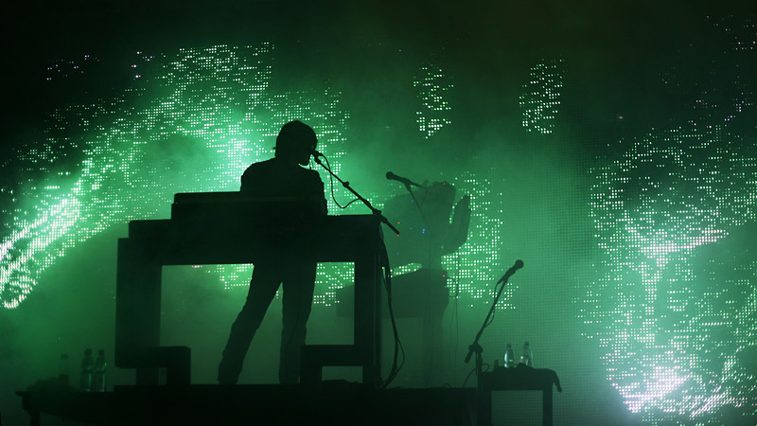
Nine Inch Nails
CC BY-NC-SA 2.0
Notes:
https://www.flickr.com/photos/nineinchnails/2997174649/

Slide 92
setlist.songs
[
TheLineBeginsToBlur.new,
OneShotWayToGetThere.new,
VariousMethodsOfEscape.new,
BranchesBones.new,
]

Slide 93
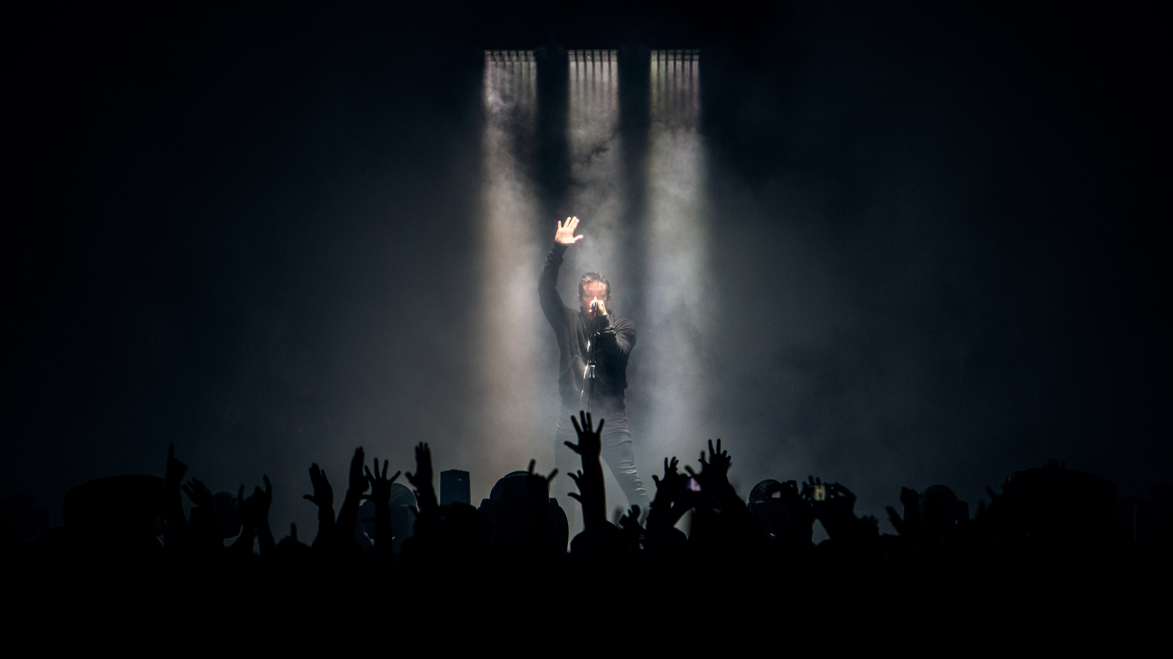
Various Methods Of Escape
Nine Inch Nails
CC BY-NC-SA 2.0
Notes:
https://www.flickr.com/photos/nineinchnails/10722216364

Slide 95
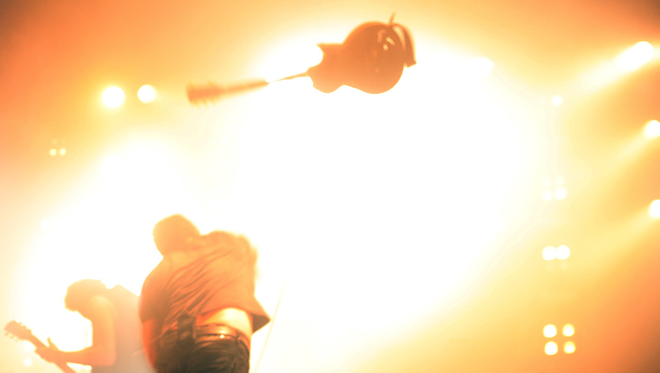
Various Methods Of Escape
Nine Inch Nails
CC BY-NC-SA 2.0
Notes:
https://www.flickr.com/photos/nineinchnails/3572822083/

Slide 96
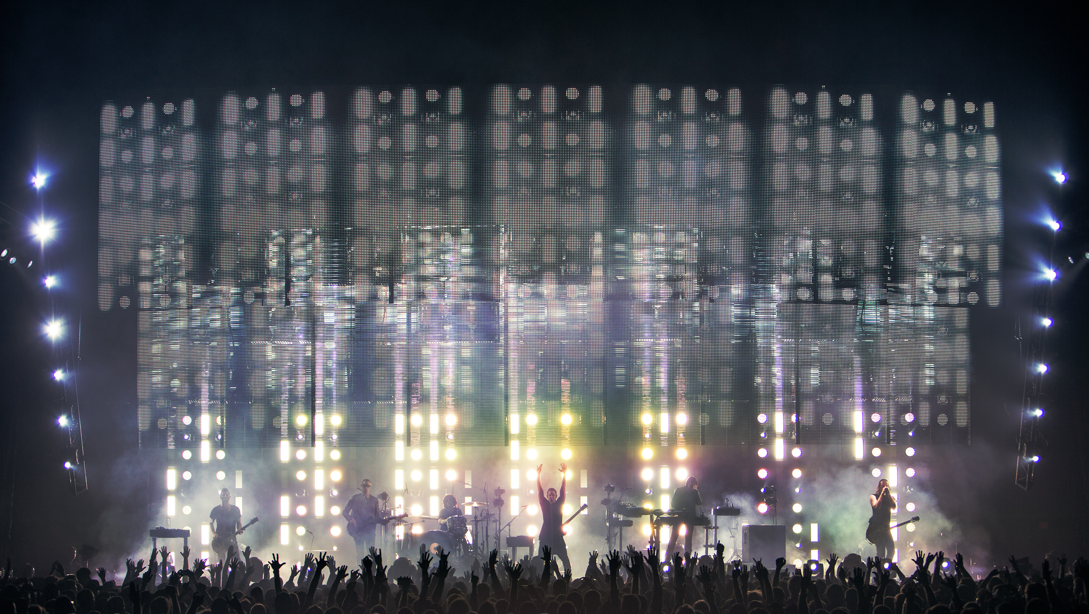
Various Methods Of Escape
Nine Inch Nails
CC BY-NC-SA 2.0
Notes:
https://www.flickr.com/photos/nineinchnails/10722275244/

Slide 97
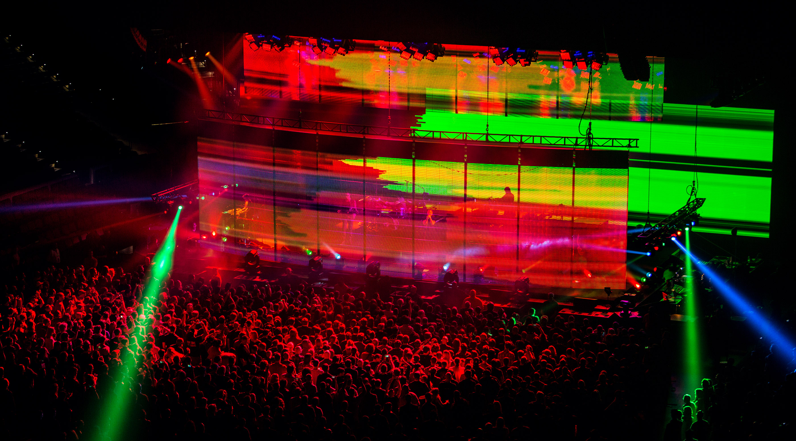
Various Methods Of Escape
Nine Inch Nails
CC BY-NC-SA 2.0
Notes:
https://www.flickr.com/photos/nineinchnails/10722195315/

Slide 98
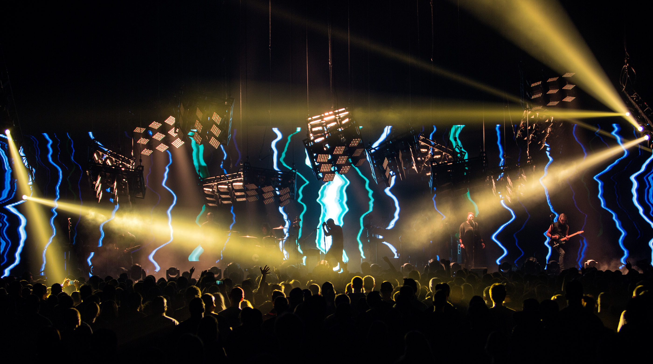
Various Methods Of Escape
Nine Inch Nails
CC BY-NC-SA 2.0
Notes:
https://www.flickr.com/photos/nineinchnails/10722461283/

Slide 99

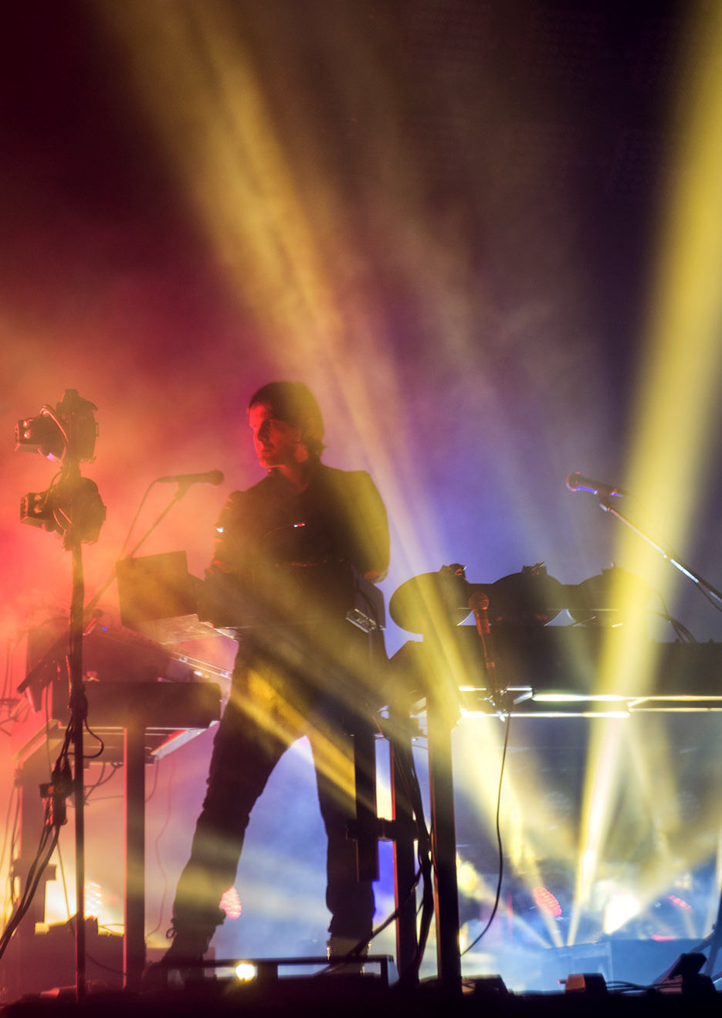
Various Methods Of Escape
Nine Inch Nails CC BY-NC-SA 2.0
class LightingController
def trigger(note)
end
end
Notes:
https://www.flickr.com/photos/nineinchnails/10722293856/

Slide 100
Various Methods Of Escape
Nine Inch Nails CC BY-NC-SA 2.0
class LightingController
def trigger(note)
composition = note.lighting
end
end
Notes:
https://www.flickr.com/photos/nineinchnails/10722293856/

Slide 101
Various Methods Of Escape
Nine Inch Nails CC BY-NC-SA 2.0
class LightingController
def trigger(note)
composition = note.lighting
@powered_lights[composition.light].trigger(
color: composition.color,
effect: composition.effect,
)
end
end
Notes:
https://www.flickr.com/photos/nineinchnails/10722293856/

Slide 102

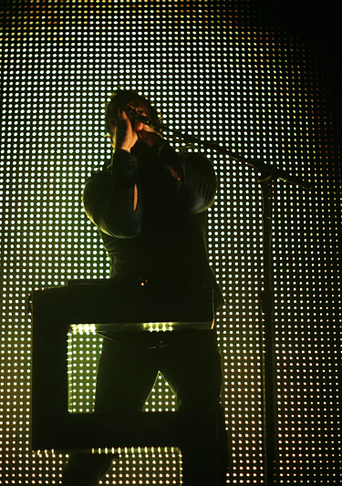
Various Methods Of Escape
Nine Inch Nails CC BY-NC-SA 2.0
class BeamProjector
def trigger(color:, effect:)
end
end
Notes:
https://www.flickr.com/photos/nineinchnails/2738931283/

Slide 103

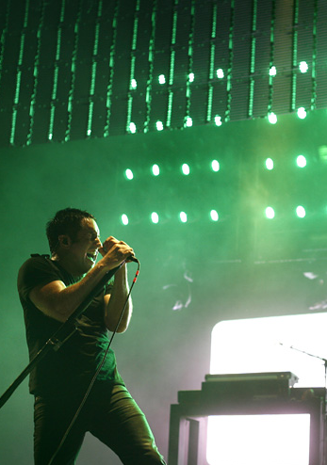
Various Methods Of Escape
Nine Inch Nails CC BY-NC-SA 2.0
class CanLight
def trigger(color:, effect:)
end
end
Notes:
https://www.flickr.com/photos/nineinchnails/2739771096/

Slide 104

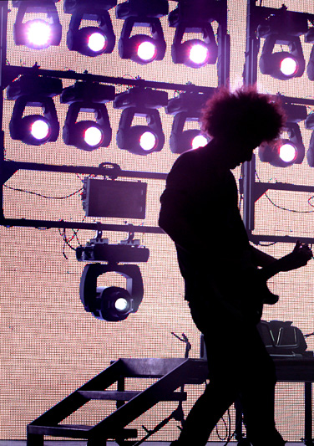
Various Methods Of Escape
Nine Inch Nails CC BY-NC-SA 2.0
class MovingLight
def trigger(color:, effect:)
end
end
Notes:
https://www.flickr.com/photos/nineinchnails/2826802685/

Slide 105

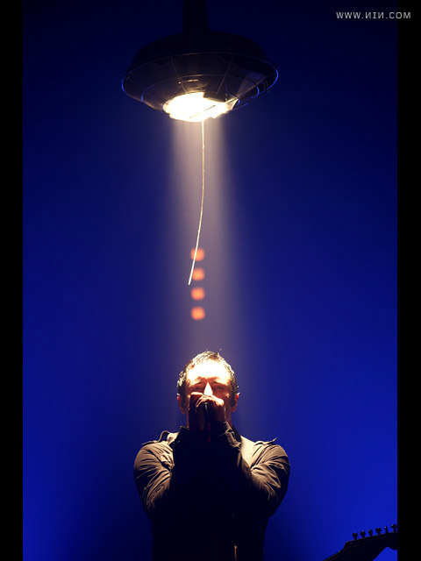
Various Methods Of Escape
Nine Inch Nails CC BY-NC-SA 2.0
class Spotlight
def trigger(color:, effect:)
end
end
Notes:
https://www.flickr.com/photos/nineinchnails/3202016537/

Slide 106
Various Methods Of Escape
# lib/lighting_inspection.rb
controller = LightingController.new
setlist.lighting = controller

Slide 107
Various Methods Of Escape
# lib/lighting_inspection.rb
controller = LightingController.new
setlist.lighting = controller
concert.set_up

Slide 108
Various Methods Of Escape
# lib/lighting_inspection.rb
controller = LightingController.new
setlist.lighting = controller
concert.set_up
concert.perform

Slide 109
Various Methods Of Escape
# lib/lighting_inspection.rb
controller = LightingController.new
setlist.lighting = controller
concert.set_up
concert.perform
concert.load_out

Slide 110
Various Methods Of Escape
require "coverage"

Slide 111
Various Methods Of Escape
require "coverage"
Coverage.start(methods: true)

Slide 112
Various Methods Of Escape
require "coverage"
Coverage.start(methods: true)
load "lib/lighting_inspection.rb"

Slide 113
Various Methods Of Escape
require "coverage"
Coverage.start(methods: true)
load "lib/lighting_inspection.rb"
result = Coverage.result

Slide 114
Various Methods Of Escape
"spotlight.rb"=>
{:methods=>{[Spotlight, :trigger, 4, 6, 6, 9]=>2}},
"beam_projector.rb"=>
{:methods=>{[BeamProjector, :trigger, 4, 6, 6, 9]=>0}},
"can_light.rb"=>
{:methods=>{[CanLight, :trigger, 4, 6, 6, 9]=>2}},
"moving_light.rb"=>
{:methods=>{[MovingLight, :trigger, 4, 6, 6, 9]=>6}},

Slide 115
Various Methods Of Escape
{
"spotlight.rb"=> {:methods=>{[Spotlight, :trigger, 4, 6, 6, 9]=>2}},
}

Slide 116
Various Methods Of Escape
File
{
"spotlight.rb"=> {:methods=>{[Spotlight, :trigger, 4, 6, 6, 9]=>2}},
}

Slide 117
Various Methods Of Escape
File
{
"spotlight.rb"=> {:methods=>{[Spotlight, :trigger, 4, 6, 6, 9]=>2}},
}
Mode

Slide 118
Various Methods Of Escape
File
method
{
"spotlight.rb"=> {:methods=>{[Spotlight, :trigger, 4, 6, 6, 9]=>2}},
}
Mode

Slide 119
Various Methods Of Escape
File
method
{
"spotlight.rb"=> {:methods=>{[Spotlight, :trigger, 4, 6, 6, 9]=>2}},
}
Mode
count

Slide 120
Various Methods Of Escape
File
method
{
"spotlight.rb"=> {:methods=>{[Spotlight, :trigger, 4, 6, 6, 9]=>2}},
}
Mode
count

Slide 121
Various Methods Of Escape
[Spotlight, :trigger, 4, 6, 6, 9] => 2

Slide 122
Various Methods Of Escape
count
[Spotlight, :trigger, 4, 6, 6, 9] => 2

Slide 123
Various Methods Of Escape
class
count
[Spotlight, :trigger, 4, 6, 6, 9] => 2

Slide 124
Various Methods Of Escape
class
count
[Spotlight, :trigger, 4, 6, 6, 9] => 2
method

Slide 125
Various Methods Of Escape
class
start line
count
[Spotlight, :trigger, 4, 6, 6, 9] => 2
method

Slide 126
Various Methods Of Escape
class
start line
count
[Spotlight, :trigger, 4, 6, 6, 9] => 2
method
start column

Slide 127
Various Methods Of Escape
end line
class
start line
count
[Spotlight, :trigger, 4, 6, 6, 9] => 2
method
start column

Slide 128
Various Methods Of Escape
end line
class
start line
count
[Spotlight, :trigger, 4, 6, 6, 9] => 2
method
start column
end column

Slide 129
Various Methods Of Escape
"spotlight.rb"=>
{:methods=>{[Spotlight, :trigger, 4, 6, 6, 9]=>2}},
"beam_projector.rb"=>
{:methods=>{[BeamProjector, :trigger, 4, 6, 6, 9]=>0}},
"can_light.rb"=>
{:methods=>{[CanLight, :trigger, 4, 6, 6, 9]=>2}},
"moving_light.rb"=>
{:methods=>{[MovingLight, :trigger, 4, 6, 6, 9]=>6}},

Slide 130
Various Methods Of Escape
"spotlight.rb"=>
{:methods=>{[Spotlight, :trigger, 4, 6, 6, 9]=>2}},
"beam_projector.rb"=>
{:methods=>{[BeamProjector, :trigger, 4, 6, 6, 9]=>0}},
"can_light.rb"=>
{:methods=>{[CanLight, :trigger, 4, 6, 6, 9]=>2}},
"moving_light.rb"=>
{:methods=>{[MovingLight, :trigger, 4, 6, 6, 9]=>6}},

Slide 131
Various Methods Of Escape
class LightingController
def turn_on_lights
@powered_lights[:beam_projector] = BeamProjector.new
@powered_lights[:can] = CanLight.new
@powered_lights[:moving_light] = MovingLight.new
@powered_lights[:spotlight] = Spotlight.new
end
end

Slide 132
Various Methods Of Escape
class LightingController
def turn_on_lights
@powered_lights[:beam_projector] = BeamProjector.new
@powered_lights[:can] = CanLight.new
@powered_lights[:moving_light] = MovingLight.new
@powered_lights[:spotlight] = Spotlight.new
end
end

Slide 133
Various Methods Of Escape
class LightingController
def turn_on_lights
@powered_lights[:beam_projector] = BeamProjector.new
@powered_lights[:can] = CanLight.new
@powered_lights[:moving_light] = MovingLight.new
@powered_lights[:spotlight] = Spotlight.new
end
end

Slide 134
Various Methods Of Escape
class LightingController
def turn_on_lights
@powered_lights[:can] = CanLight.new
@powered_lights[:moving_light] = MovingLight.new
@powered_lights[:spotlight] = Spotlight.new
end
end

Slide 135
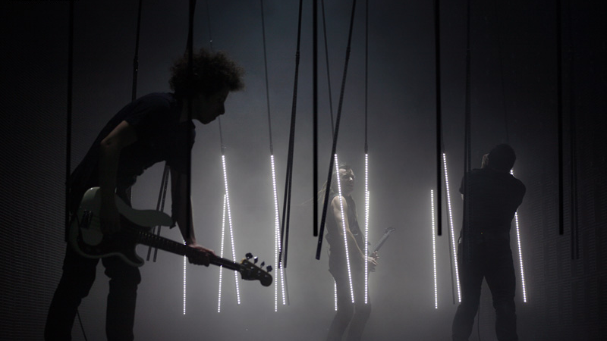
Nine Inch Nails
CC BY-NC-SA 2.0
Notes:
https://www.flickr.com/photos/nineinchnails/2738948949/

Slide 136
setlist.songs
[
TheLineBeginsToBlur.new,
OneShotWayToGetThere.new,
VariousMethodsOfEscape.new,
BranchesBones.new,
]

Slide 137
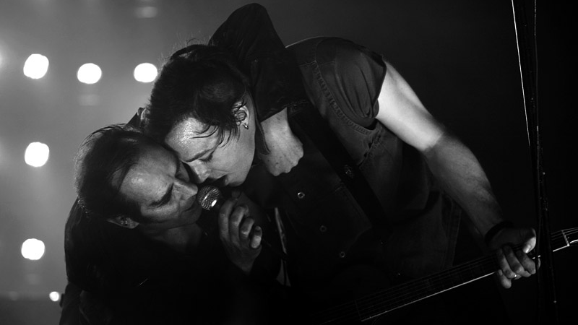
Nine Inch Nails
CC BY-NC-SA 2.0
Notes:
https://www.flickr.com/photos/nineinchnails/3032765125/

Slide 138
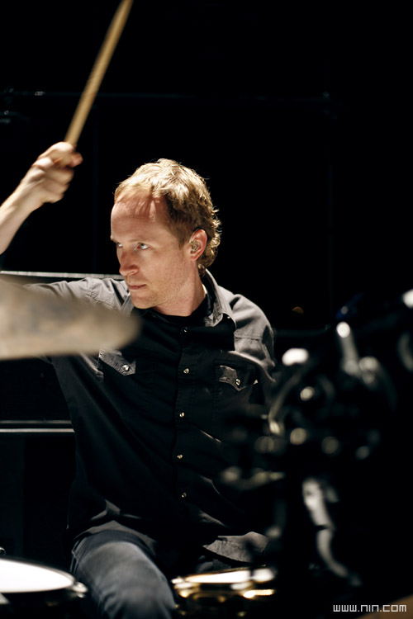
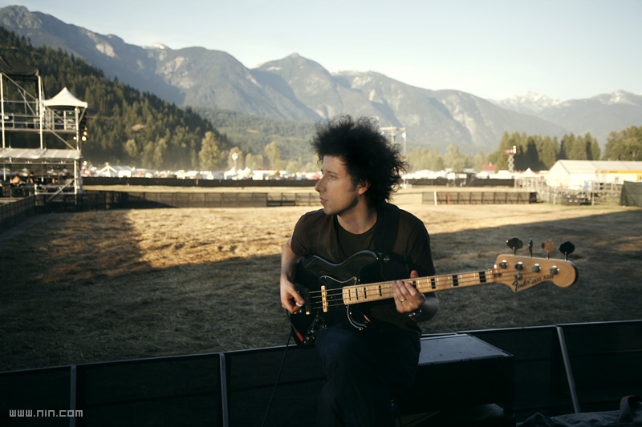
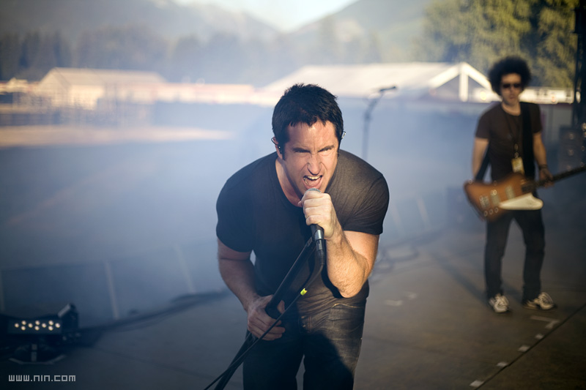
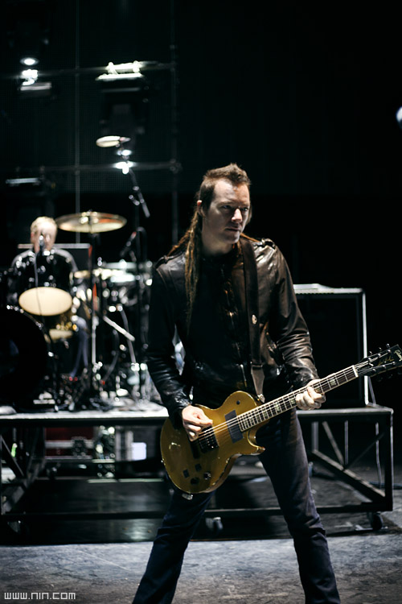
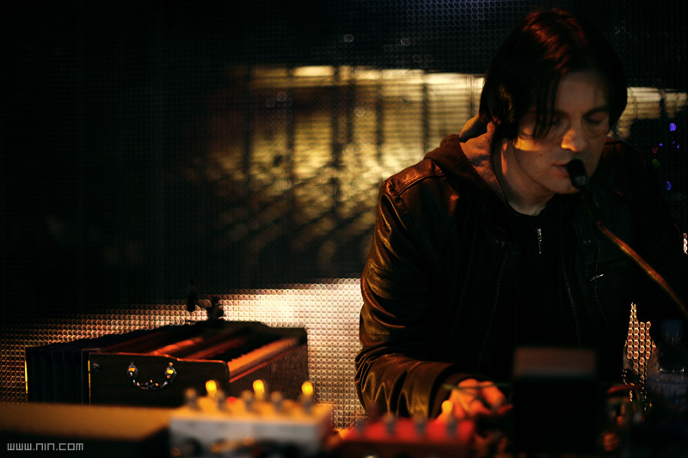
Nine Inch Nails
CC BY-NC-SA 2.0
Nine Inch Nails
CC BY-NC-SA 2.0
Nine Inch Nails
CC BY-NC-SA 2.0
Nine Inch Nails
CC BY-NC-SA 2.0
Nine Inch Nails
CC BY-NC-SA 2.0
Notes:
https://www.flickr.com/photos/nineinchnails/2997970466/
https://www.flickr.com/photos/nineinchnails/2997970974/
https://www.flickr.com/photos/nineinchnails/2739752862/
https://www.flickr.com/photos/nineinchnails/2738913701/
https://www.flickr.com/photos/nineinchnails/2997202615/

Slide 139
Branches/Bones
# lib/rehearsal.rb
song = BranchesBones.new

Slide 140
Branches/Bones
# lib/rehearsal.rb
song = BranchesBones.new
song.performers = band

Slide 141
Branches/Bones
# lib/rehearsal.rb
song = BranchesBones.new
song.performers = band
song.play

Slide 142
Branches/Bones
require "coverage"

Slide 143
Branches/Bones
require "coverage"
Coverage.start(:all)

Slide 144
Branches/Bones
require "coverage"
Coverage.start(:all)
load "lib/rehearsal.rb"

Slide 145
Branches/Bones
require "coverage"
Coverage.start(:all)
load "lib/rehearsal.rb"
result = Coverage.result

Slide 146
Branches/Bones
"branches_bones.rb"=>{
:lines=>[1, 1, 1, 1, 1, nil, nil, nil, nil, nil, 1, nil, 1, nil, 1, nil, nil, nil, 1, nil, 1, nil, nil, nil, 1, nil, 1, nil, nil, nil, nil, nil, 1, 2, nil, nil, 2, nil, nil, nil, nil, 2, nil, 2, 8, nil, nil, nil, nil, nil],
:branches=>{[:if, 0, 34, 25, 34, 67]=>{[:then, 1, 34, 60, 34, 62]=>0, [:else, 2, 34, 65, 34, 67]=>2}, [:if, 3, 42, 18, 42, 99]=>{[:then, 4, 42, 41, 42, 75]=>0, [:else, 5, 42, 78, 42, 99]=>2}},
:methods=>{
[RubyCoverBand::Songs::BranchesBones, :chorus, 33, 6, 47, 9]=>2
[RubyCoverBand::Songs::BranchesBones, :outro, 25, 6, 29, 9]=>1,
[RubyCoverBand::Songs::BranchesBones, :verse_2, 19, 6, 23, 9]=>1,
[RubyCoverBand::Songs::BranchesBones, :verse_1, 13, 6, 17, 9]=>1,
[RubyCoverBand::Songs::BranchesBones, :initialize, 4, 6, 9, 9]=>1}},

Slide 147
Branches/Bones
"branches_bones.rb"=>{
:lines=>[1, 1, 1, 1, 1, nil, nil, nil, nil, nil, 1, nil, 1, nil, 1, nil, nil, nil, 1, nil, 1, nil, nil, nil, 1, nil, 1, nil, nil, nil, nil, nil, 1, 2, nil, nil, 2, nil, nil, nil, nil, 2, nil, 2, 8, nil, nil, nil, nil, nil],
:branches=>{[:if, 0, 34, 25, 34, 67]=>{[:then, 1, 34, 60, 34, 62]=>0, [:else, 2, 34, 65, 34, 67]=>2}, [:if, 3, 42, 18, 42, 99]=>{[:then, 4, 42, 41, 42, 75]=>0, [:else, 5, 42, 78, 42, 99]=>2}},
:methods=>{
[RubyCoverBand::Songs::BranchesBones, :chorus, 33, 6, 47, 9]=>2
[RubyCoverBand::Songs::BranchesBones, :outro, 25, 6, 29, 9]=>1,
[RubyCoverBand::Songs::BranchesBones, :verse_2, 19, 6, 23, 9]=>1,
[RubyCoverBand::Songs::BranchesBones, :verse_1, 13, 6, 17, 9]=>1,
[RubyCoverBand::Songs::BranchesBones, :initialize, 4, 6, 9, 9]=>1}},

Slide 148
Branches/Bones
song_coverage = result["branches_bones.rb"]
song_coverage.keys

Slide 149
Branches/Bones
song_coverage = result["branches_bones.rb"]
song_coverage.keys
=> [:lines, :methods, :branches]

Slide 150
Branches/Bones
song_coverage[:lines].include?(0)
=> false

Slide 151
Branches/Bones
song_coverage[:methods].values.include?(0)
=> false

Slide 152
Branches/Bones
song_coverage[:branches]
=> {[:if, 0, 34, 25, 34, 67]=>{
[:then, 1, 34, 60, 34, 62]=>0,
[:else, 2, 34, 65, 34, 67]=>2,
}}

Slide 153
Branches/Bones
{
"branches_bones.rb" => { :branches =>
{[:if, 0, 34, 25, 34, 67] => {
[:then, 1, 34, 60, 34, 62] => 0,
[:else, 2, 34, 65, 34, 67] => 2,
}}
}
}

Slide 154
Branches/Bones
File
{
"branches_bones.rb" => { :branches =>
{[:if, 0, 34, 25, 34, 67] => {
[:then, 1, 34, 60, 34, 62] => 0,
[:else, 2, 34, 65, 34, 67] => 2,
}}
}
}

Slide 155
Branches/Bones
File
mode
{
"branches_bones.rb" => { :branches =>
{[:if, 0, 34, 25, 34, 67] => {
[:then, 1, 34, 60, 34, 62] => 0,
[:else, 2, 34, 65, 34, 67] => 2,
}}
}
}

Slide 156
Branches/Bones
File
mode
{
"branches_bones.rb" => { :branches =>
{[:if, 0, 34, 25, 34, 67] => {
[:then, 1, 34, 60, 34, 62] => 0,
[:else, 2, 34, 65, 34, 67] => 2,
}}
}
}
conditional

Slide 157
Branches/Bones
File
mode
{
"branches_bones.rb" => { :branches =>
{[:if, 0, 34, 25, 34, 67] => {
[:then, 1, 34, 60, 34, 62] => 0,
[:else, 2, 34, 65, 34, 67] => 2,
}}
}
}
conditional
branch

Slide 158
Branches/Bones
File
mode
{
"branches_bones.rb" => { :branches =>
{[:if, 0, 34, 25, 34, 67] => {
[:then, 1, 34, 60, 34, 62] => 0,
[:else, 2, 34, 65, 34, 67] => 2,
}}
}
}
conditional
branch
branch

Slide 159
Branches/Bones
File
mode
{
"branches_bones.rb" => { :branches =>
{[:if, 0, 34, 25, 34, 67] => {
[:then, 1, 34, 60, 34, 62] => 0,
[:else, 2, 34, 65, 34, 67] => 2,
}}
}
}
conditional
branch
branch

Slide 160
Branches/Bones
[:then, 1, 34, 60, 34, 62] => 0

Slide 161
Branches/Bones
count
[:then, 1, 34, 60, 34, 62] => 0

Slide 162
Branches/Bones
branch
count
[:then, 1, 34, 60, 34, 62] => 0

Slide 163
Branches/Bones
branch
count
[:then, 1, 34, 60, 34, 62] => 0
id

Slide 164
Branches/Bones
branch
start line
count
[:then, 1, 34, 60, 34, 62] => 0
id

Slide 165
Branches/Bones
branch
start line
count
[:then, 1, 34, 60, 34, 62] => 0
id
start column

Slide 166
Branches/Bones
end line
branch
start line
count
[:then, 1, 34, 60, 34, 62] => 0
id
start column

Slide 167
Branches/Bones
end line
branch
start line
count
[:then, 1, 34, 60, 34, 62] => 0
id
start column
end column

Slide 168
Branches/Bones
32
33
34
35
class BranchesBones < Song
def chorus(number)
echo_intensity = number.positive? && number.even? ? 10 : 30
…
Lyric.new(line: line, effect: :echo, effect_level: echo_intensity)
end
60
62

Slide 169
Branches/Bones
class BranchesBones < Song
def initialize
notes = verse_1 + chorus(0) + verse_2 + chorus(1) + outro
end
def chorus(number)
echo_intensity = number.positive? && number.even? ? 10 : 30
end

Slide 170
Branches/Bones
class BranchesBones < Song
def initialize
notes = verse_1 + chorus(0) + verse_2 + chorus(1) + outro
end
def chorus(number)
echo_intensity = number.positive? && number.even? ? 10 : 30
end

Slide 171
Branches/Bones
class BranchesBones < Song
def initialize
notes = verse_1 + chorus(1) + verse_2 + chorus(2) + outro
end
def chorus(number)
echo_intensity = number.positive? && number.even? ? 10 : 30
end

Slide 172
Branches/Bones
song_coverage[:branches]
=> {[:if, 0, 34, 25, 34, 67]=>{
[:then, 1, 34, 60, 34, 62]=>1,
[:else, 2, 34, 65, 34, 67]=>1,
}}

Slide 173
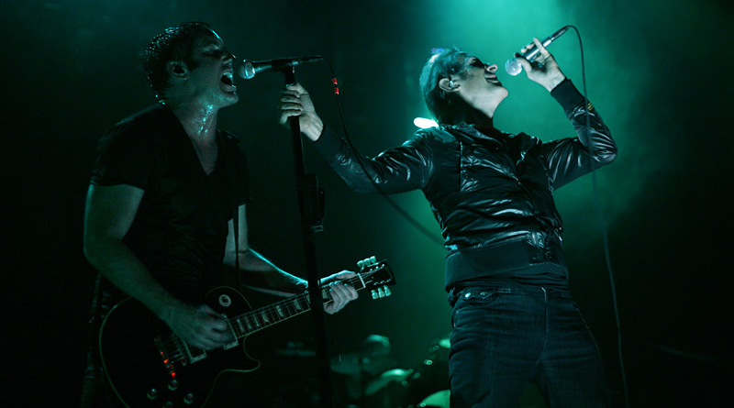
Branches/Bones
Nine Inch Nails
CC BY-NC-SA 2.0
Notes:
https://www.flickr.com/photos/nineinchnails/3017100564/

Slide 174
encore

Slide 175
coverage.summary
{
}

Slide 176
coverage.summary
{
lines: "how many times was each line executed?",
}

Slide 177
coverage.summary
{
lines: "how many times was each line executed?",
oneshot_lines: "which lines were executed?",
}

Slide 178
coverage.summary
{
lines: "how many times was each line executed?",
oneshot_lines: "which lines were executed?",
methods: "how many times was each method executed?",
}

Slide 179
coverage.summary
{
lines: "how many times was each line executed?",
oneshot_lines: "which lines were executed?",
methods: "how many times was each method executed?",
branches: "how many times was each branch executed?",
}

Slide 180

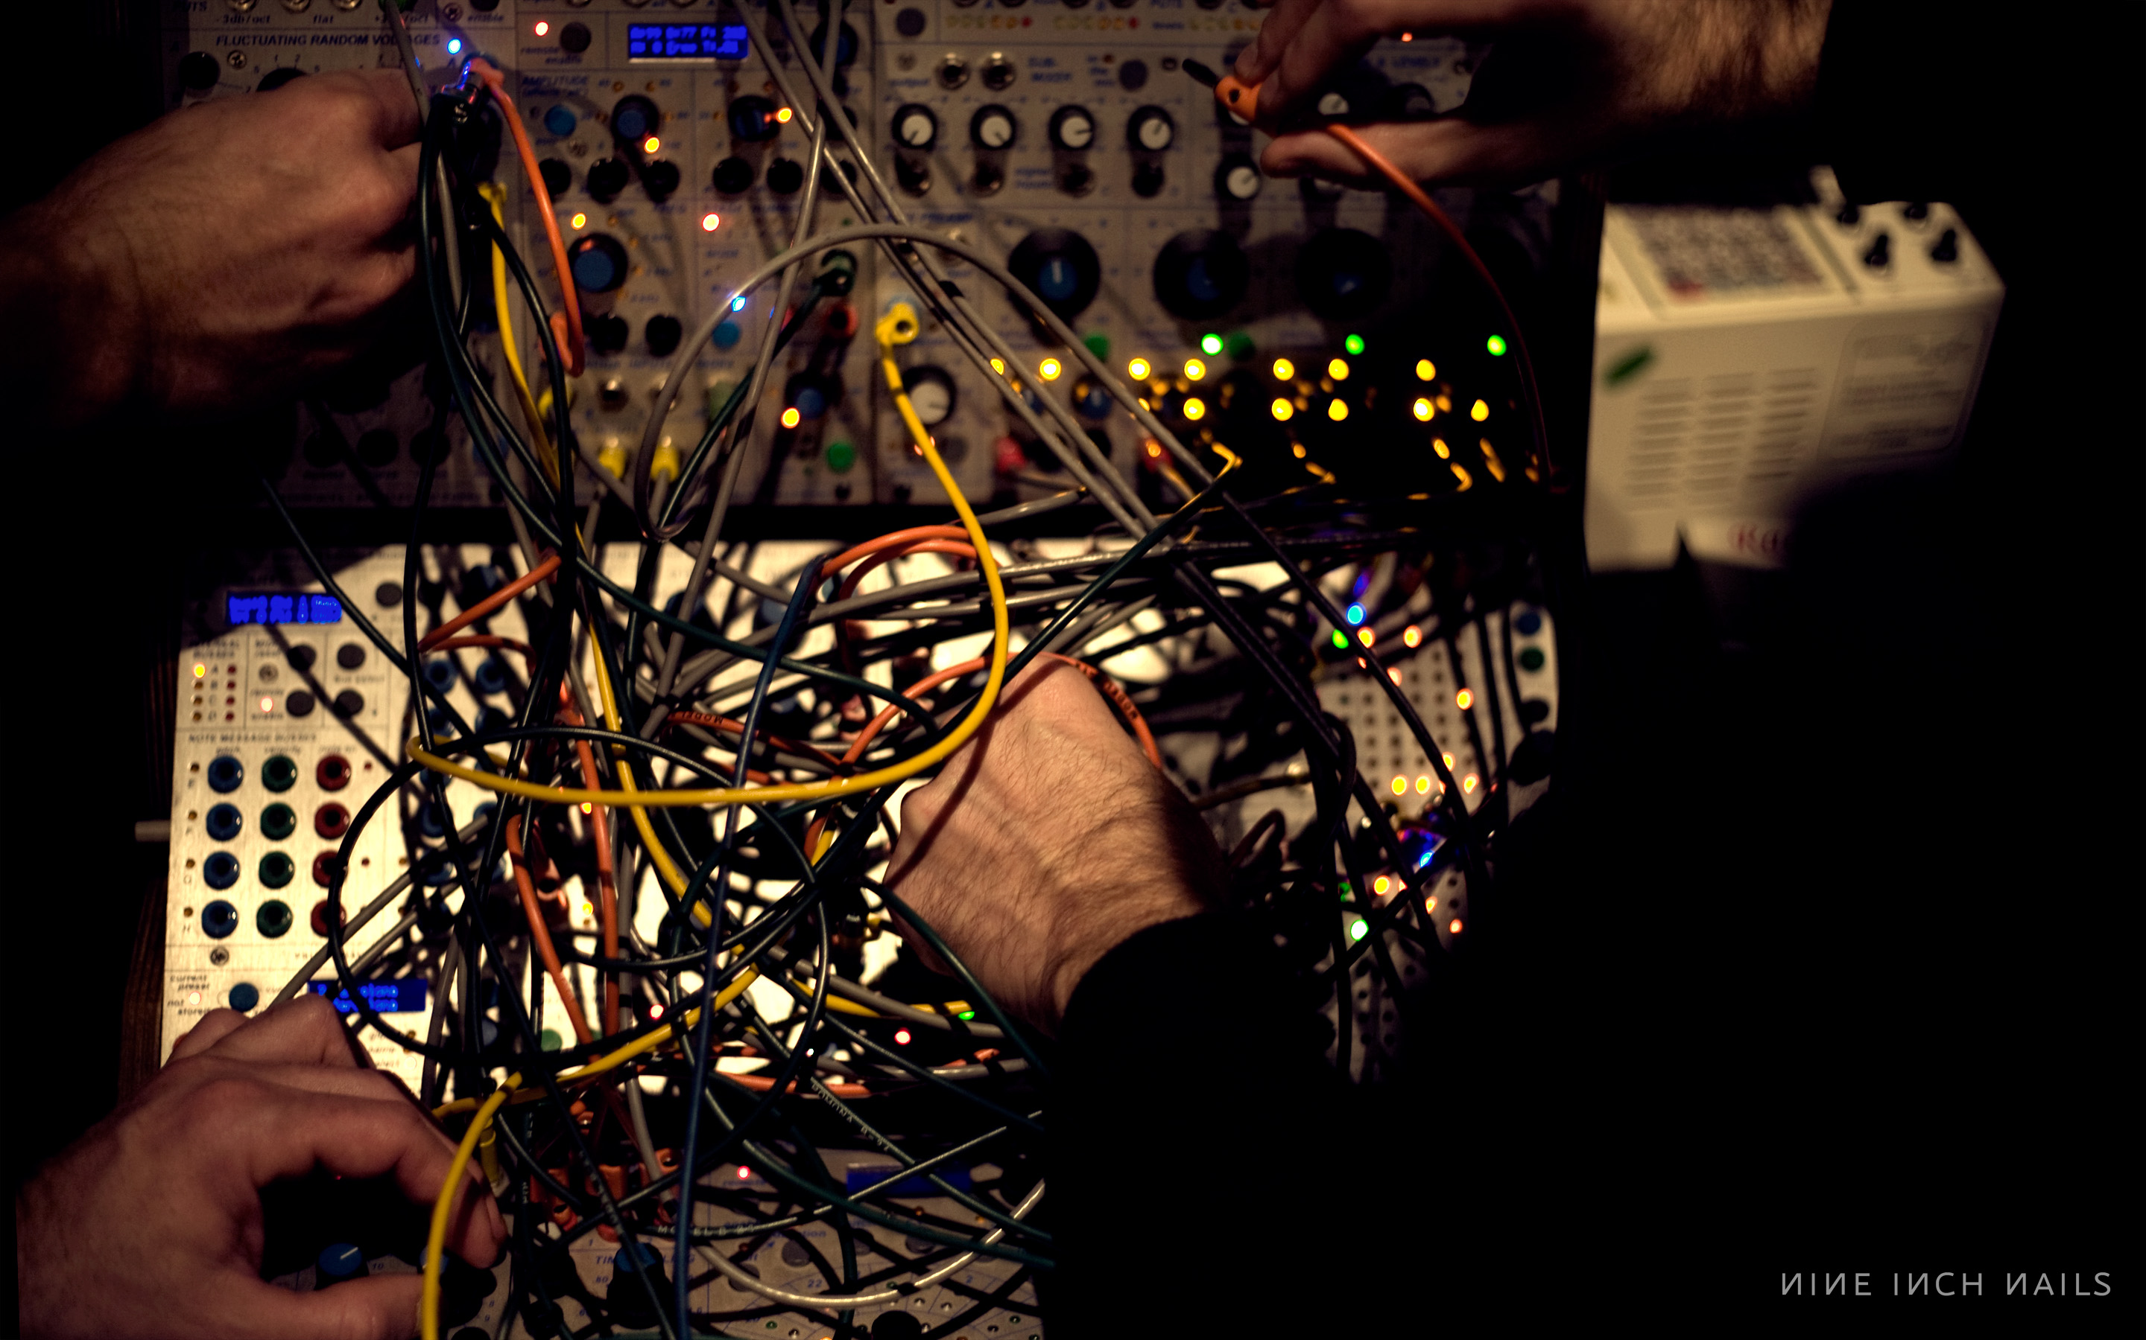
Supporting Instruments
Nine Inch Nails CC BY-NC-SA 2.0
SimpleCov
Coverband
https://thegnar.co
Notes:
https://www.flickr.com/photos/nineinchnails/7376287862/

Slide 181

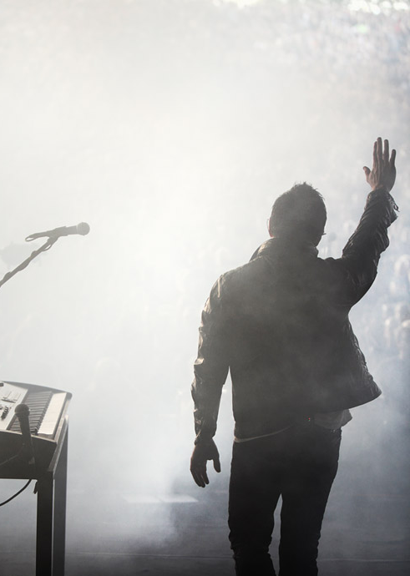
@kevin_j_m
Nine Inch Nails CC BY-NC-SA 2.0
kevinjmurphy.com/coverage
https://thegnar.co
Notes:
https://www.flickr.com/photos/nineinchnails/3639141695/

